Slide 1
Manipulating Images
Mack 2021

Slide 2
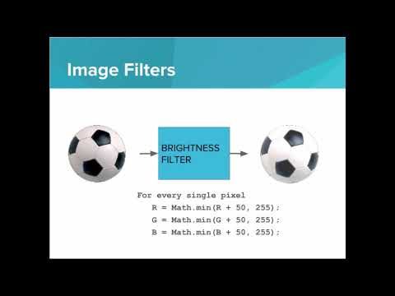
We learn about the manipulating pixel data to create image filters

Slide 3



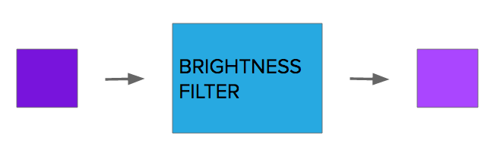

We want to write a brightness filter that brightens a given pixel.
Which of the following instructions would brighten a pixel? Assume R is the red value of the pixel, G is the green value, and B is the blue value.
Notes:
🍐 This is a Pear Deck Multiple Choice Slide. Your current options are: A: A, B: B, C: C, D: D,
🍐 To edit the type of question or choices, go back to the "Ask Students a Question" in the Pear Deck sidebar.
B

Slide 4

We learn about writing image filters in JavaScript with the WebImage API

Slide 5
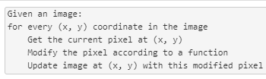
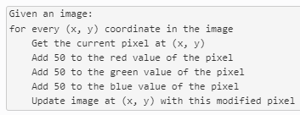
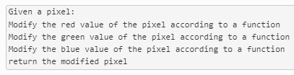

Which of the following describes the instructions for a general image filter?
Notes:
🍐 This is a Pear Deck Multiple Choice Slide. Your current options are: A: A, B: B, C: C, D: D,
🍐 To edit the type of question or choices, go back to the "Ask Students a Question" in the Pear Deck sidebar.
A

Slide 6
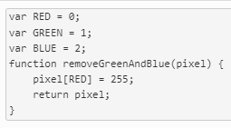
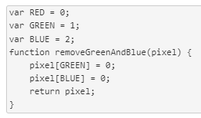
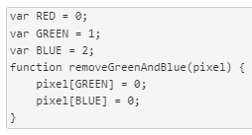
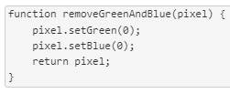
Which of the following functions properly removes all green and blue from a pixel and returns the modified pixel?
Notes:
🍐 This is a Pear Deck Multiple Choice Slide. Your current options are: A: A, B: B, C: C, D: D,
🍐 To edit the type of question or choices, go back to the "Ask Students a Question" in the Pear Deck sidebar.
B

Slide 7
Example: Black and White Filter
This is an example for this lesson. You are encouraged to play around with it, run and change the code, and learn how it works. When you are done, click continue to go to the next problem.

Slide 8
Brighten Filter
This is an example for this lesson. You are encouraged to play around with it, run and change the code, and learn how it works. When you are done, click continue to go to the next problem.

